Slide 1
Cryptography and Network Security
EMAIL SECURITY

Slide 2
Session Meta Data
Author | Dr T Sree Sharmila
Reviewer
Version Number | 1.0
Release Date | 10 August 2018

Slide 3
Revision History
Revision Date | Details | Version no.
 |  | 1.0

Slide 4
Agenda
Email Security
Enhancements
Pretty Good Privacy (PGP)
Operation
Session keys
Key rings
Key management
S/MIME
Function
Cryptography algorithm
Certificate process
Certificate authorities
Summary
Test your understanding
References

Slide 5
Email Security
email is one of the most widely used and regarded network services
currently message contents are not secure
may be inspected either in transit
or by suitably privileged users on destination system
Notes:
Current email services are roughly like "postcards". Anyone who wants could pick it up and have a look as its in transit or sitting in the recipients mailbox.

Slide 6
Agenda
Email Security
Enhancements
Pretty Good Privacy (PGP)
Operation
Session keys
Key rings
Key management
S/MIME
Function
Cryptography algorithm
Certificate process
Certificate authorities
Summary
Test your understanding
References

Slide 7
Email Security Enhancements
confidentiality
protection from disclosure
authentication
of sender of message
message integrity
protection from modification
non-repudiation of origin
protection from denial by sender
Notes:
What we want is something more akin to standard mail (contents protected inside an envelope) if not registered mail (have confidence about the sender of the mail and its contents).

Slide 8
Agenda
Email Security
Enhancements
Pretty Good Privacy (PGP)
Operation
Session keys
Key rings
Key management
S/MIME
Function
Cryptography algorithm
Certificate process
Certificate authorities
Summary
Test your understanding
References

Slide 9
Pretty Good Privacy (PGP)
widely used de facto secure email
developed by Phil Zimmermann
selected best available crypto algs to use
integrated into a single program
available on Unix, PC, Macintosh and Amiga systems
originally free, now have commercial versions available also

Slide 10
Agenda
Email Security
Enhancements
Pretty Good Privacy (PGP)
Operation
Session keys
Key rings
Key management
S/MIME
Function
Cryptography algorithm
Certificate process
Certificate authorities
Summary
Test your understanding
References

Slide 11
PGP Operation – Authentication
sender creates a message
SHA-1 used to generate 160-bit hash code of message
hash code is encrypted with RSA using the sender's private key, and result is attached to message
receiver uses RSA or DSS with sender's public key to decrypt and recover hash code
receiver generates new hash code for message and compares with decrypted hash code, if match, message is accepted as authentic

Slide 12
PGP Operation – Confidentiality
sender generates message and random 128-bit number to be used as session key for this message only
message is encrypted, using CAST-128 / IDEA/3DES with session key
session key is encrypted using RSA with recipient's public key, then attached to message
receiver uses RSA with its private key to decrypt and recover session key
session key is used to decrypt message

Slide 13
PGP Operation – Confidentiality & Authentication
uses both services on same message
create signature & attach to message
encrypt both message & signature
attach RSA encrypted session key

Slide 14
PGP Operation – Compression
by default PGP compresses message after signing but before encrypting
so can store uncompressed message & signature for later verification
& because compression is non deterministic
uses ZIP compression algorithm

Slide 15
PGP Operation – Email Compatibility
when using PGP will have binary data to send (encrypted message etc)
however email was designed only for text
hence PGP must encode raw binary data into printable ASCII characters
uses radix-64 algorithm
maps 3 bytes to 4 printable chars
also appends a CRC
PGP also segments messages if too big

Slide 16
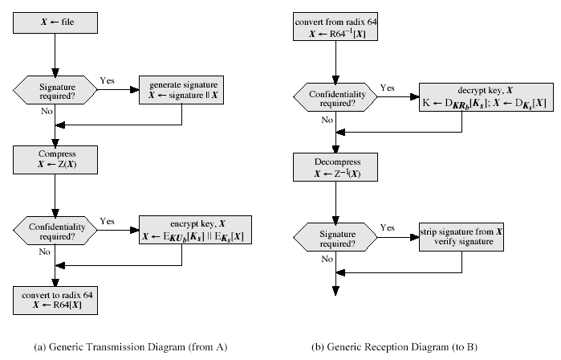
PGP Operation – Summary
Notes:
Stallings Fig 15-2.

Slide 17
Agenda
Email Security
Enhancements
Pretty Good Privacy (PGP)
Operation
Session keys
Key rings
Key management
S/MIME
Function
Cryptography algorithm
Certificate process
Certificate authorities
Summary
Test your understanding
References

Slide 18
PGP Session Keys
need a session key for each message
of varying sizes: 56-bit DES, 128-bit CAST or IDEA, 168-bit Triple-DES
generated using ANSI X12.17 mode
uses random inputs taken from previous uses and from keystroke timing of user

Slide 19
PGP Public & Private Keys
since many public/private keys may be in use, need to identify which is actually used to encrypt session key in a message
could send full public-key with every message
but this is inefficient
rather use a key identifier based on key
is least significant 64-bits of the key
will very likely be unique
also use key ID in signatures

Slide 20
Agenda
Email Security
Enhancements
Pretty Good Privacy (PGP)
Operation
Session keys
Key rings
Key management
S/MIME
Function
Cryptography algorithm
Certificate process
Certificate authorities
Summary
Test your understanding
References

Slide 21
PGP Key Rings
each PGP user has a pair of keyrings:
public-key ring contains all the public-keys of other PGP users known to this user, indexed by key ID
private-key ring contains the public/private key pair(s) for this user, indexed by key ID & encrypted keyed from a hashed passphrase

Slide 22
Agenda
Email Security
Enhancements
Pretty Good Privacy (PGP)
Operation
Session keys
Key rings
Key management
S/MIME
Function
Cryptography algorithm
Certificate process
Certificate authorities
Summary
Test your understanding
References

Slide 23
PGP Key Management
rather than relying on certificate authorities
in PGP every user is own CA
can sign keys for users they know directly
forms a “web of trust”
trust keys have signed
can trust keys others have signed if have a chain of signatures to them
key ring includes trust indicators
users can also revoke their keys

Slide 24
Agenda
Email Security
Enhancements
Pretty Good Privacy (PGP)
Operation
Session keys
Key rings
Key management
S/MIME
Function
Cryptography algorithm
Certificate process
Certificate authorities
Summary
Test your understanding
References

Slide 25
S/MIME (Secure/Multipurpose Internet Mail Extensions)
security enhancement to MIME email
original Internet RFC822 email was text only
MIME provided support for varying content types and multi-part messages
with encoding of binary data to textual form
S/MIME added security enhancements
have S/MIME support in various modern mail agents: MS Outlook, Netscape etc

Slide 26
Agenda
Email Security
Enhancements
Pretty Good Privacy (PGP)
Operation
Session keys
Key rings
Key management
S/MIME
Function
Cryptography algorithm
Certificate process
Certificate authorities
Summary
Test your understanding
References

Slide 27
S/MIME Functions
enveloped data
encrypted content and associated keys
signed data
encoded message + signed digest
clear-signed data
cleartext message + encoded signed digest
signed & enveloped data
nesting of signed & encrypted entities

Slide 28
Agenda
Email Security
Enhancements
Pretty Good Privacy (PGP)
Operation
Session keys
Key rings
Key management
S/MIME
Function
Cryptography algorithm
Certificate process
Certificate authorities
Summary
Test your understanding
References

Slide 29
S/MIME Cryptographic Algorithms
hash functions: SHA-1 & MD5
digital signatures: DSS & RSA
session key encryption: ElGamal & RSA
message encryption: Triple-DES, RC2/40 and others
have a procedure to decide which algorithms to use

Slide 30
Agenda
Email Security
Enhancements
Pretty Good Privacy (PGP)
Operation
Session keys
Key rings
Key management
S/MIME
Function
Cryptography algorithm
Certificate process
Certificate authorities
Summary
Test your understanding
References

Slide 31
S/MIME Certificate Processing
S/MIME uses X.509 v3 certificates
managed using a hybrid of a strict X.509 CA hierarchy & PGP’s web of trust
each client has a list of trusted CA’s certs
and own public/private key pairs & certs
certificates must be signed by trusted CA’s

Slide 32
Agenda
Email Security
Enhancements
Pretty Good Privacy (PGP)
Operation
Session keys
Key rings
Key management
S/MIME
Function
Cryptography algorithm
Certificate process
Certificate authorities
Summary
Test your understanding
References

Slide 33
Certificate Authorities
have several well-known CA’s
Verisign one of most widely used
Verisign issues several types of Digital IDs
with increasing levels of checks & hence trust
Class Identity Checks Usage
1 name/email check web browsing/email
2+ enroll/addr check email, subs, s/w validate
3+ ID documents e-banking/service access

Slide 34
Agenda
Email Security
Enhancements
Pretty Good Privacy (PGP)
Operation
Session keys
Key rings
Key management
S/MIME
Function
Cryptography algorithm
Certificate process
Certificate authorities
Summary
Test your understanding
References

Slide 35
Summary
have considered:
secure email
PGP
S/MIME

Slide 36
Test your understanding
Explain PGP in detail.
Explain S/MIME in detail.

Slide 37
References
1. William Stallings, Cryptography and Network Security, 6th Edition, Pearson Education, March 2013.
2. Charlie Kaufman, Radia Perlman and Mike Speciner, “Network Security”, Prentice Hall of India, 2002.

